Slide 1

CMR COLLEGE OF ENGINEERING & TECHNOLOGY
Kandlakoya, Medchal, Hyderabad - 501401
Department of Computer Science and Engineering
SENTIMENT ANALYSIS BASED ON TRAVELERS’ REVIEWS USING THE SVM MODEL WITH ENHANCED CONJUNCTION RULE-BASED APPROACH
Name of the student
B. Pooja
(20H51A05B4)
B. Akhil Goud (20H51A0558)
Under the esteemed guidance of
Major Dr. V. A. Narayana (Professor of CSE & Principal of CMRCET)

Slide 2
Outline
Abstract
Introduction
Literature survey
Existing system
- Problems in the existing system
Research Objective of Presentation
Problem Definition
Research work
- Proposed system architecture
- Methods
- Comparison of the Proposed system with an existing system
Performance Measure
Results
Conclusion
Future Work
References
Notes:
2

Slide 3
Abstract
Notes:
3

Slide 4
ABSTRACT
There are many reviews on social media, and its difficult for tourism organizations to analyze them manually.
Social media is growing trend now a days. Every day millions of user review and rate the tourist places on tourism websites.
Sentiment Analysis can be performed over these reviews which will be helpful to find tourist place popularity. By applying sentiment classification, reviews can be classified into several classes.
The reviews contain noisy contents, such as typos and emotions, which could affect the accuracy of the classifiers. Based on sentiment analysis result, tourist can easily decide tour destination to be visited.
In this project sentiment analysis has been implemented using machine learning Approach called SVM. The dataset has been collected from various tourism websites.
The reviews are labelled into 3 sentiments: positive, neutral and negative. The
Performance is evaluated using enhanced conjunction rule based approach
to determine the best review from overall.

Slide 5
INTRODUCTION
Notes:
5

Slide 6
Introduction
Social media is rapidly growing now a days. Millions of users post reviews and rate tourist place on a daily basis over tourism websites.
For analyzing the reviews sentiment analysis can be performed. Proper Analysis of reviews will be able to find a trend of tourist place popularity.
The project's primary objective is to analyze the reviews and classify the reviews based on the tourist reviews.
The main phase in the project consists of data collection, preparation,
labelling and modelling.
The reviews are labelled into three sentiments: positive, neutral and
Negative sentiments.
Notes:
6

Slide 7
Literature Survey
Notes:
7

Slide 8
Existing system
Existing Method 1: Sentiment classification from reviews for tourism analytics
The tourism industry, a global economic powerhouse, is now intertwined with technology, allowing tourists to share their experiences on social media platforms. Analyzing the massive volume of reviews poses challenges, but sentiment classification models offer a solution. This study, using data from TripAdvisor and Google reviews, identifies the Support Vector Machine as the most effective classifier (67.97% accuracy), providing valuable insights for the industry.
Demerits
• Handling a large volume of reviews is a challenge.
• Noisy content can harm analysis accuracy.
Challenges
Managing numerous social media reviews.
Dealing with noisy content.
Selecting the best sentiment classifier for tourism.
Notes:
8

Slide 9
Existing system
Existing Method 2: Sentiment analysis from travelers’ reviews using enhanced conjunction rule-based approach for feature-specific evaluation of hotels
Introducing an enhanced approach for feature-specific sentiment analysis of hotel reviews, this paper tackles information overload in online feedback. By precisely segregating sentences into relevant clauses, it assesses aspects like food, service, and location, offering a more comprehensive understanding for readers.
Demerits
• May still face challenges in handling nuanced or context-dependent sentiments.
• Requires careful feature identification in reviews.
Challenges
• Developing and maintaining an extensive lexicon for accurate sentiment analysis.
• Handling context-dependent sentiments and nuances in reviews.
• Precisely identifying and associating features with sentiments in a wide range of reviews.

Slide 10
Research Objective
Notes:
10

Slide 11
Research objective
The research objective of the project is to create a sentiment analysis system tailored for traveler’s reviews using a combination of Support Vector Machine (SVM) modeling and an enhanced conjunction rule-based approach.

Slide 12
Problem Definition
Notes:
12

Slide 13
Problem Definition
Implementation of sentiment analysis is not easy. Travellers' frequently desire to know the attraction for which city they wish to visit.
They research social media sites for recommendations, opinions, and reviews to visit tourist destinations.
To extract the feature-specific feedback or best review from given text passages is a challenging task.
For that it is needed to identify and correlate specific texts with the specific features.

Slide 14
Research Work
Notes:
14

Slide 15
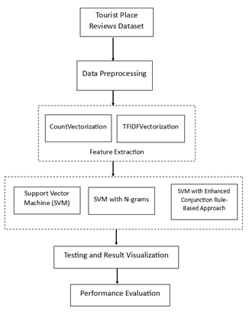
Proposed system architecture

Slide 16
Proposed Method
In this paper we are using machine learning algorithms such as SVM to predict sentiments from tourist reviews dataset and then evaluating performance of N-Gram and Conjunction rule based features extraction algorithms.
The research uses review data from various tourism which websites. Data has been collected in CSV format consists of review text and associated rating. From rating we calculated sentiment whether positive, negative or neutral. If rating is greater than 3 then it is considered as positive if less than 3 then it is considered as negative and if equal to 3 then it is considered as neutral.
The users can login to the website and can find the tourism data, they have access to search about various places which they want to do analysis. They will get the prediction result based on the data they have searched.
The admin can login and then he can have access to the user i.e.. They can activate the user in order to provide the dataset.

Slide 17
Proposed Methods
Our project has designed a proposed solution with comparisons of 3 classifiers SVM, SVM with n-grams, and SVM with Conjunction Rule-Based Approach.
The following procedures are used in our system to do sentiment analysis.
A. Data Set
In this study, the researchers collected review data from different tourism websites. The data was stored in a CSV format and included review text along with corresponding ratings. They were able to ascertain if the reviewers' sentiments were favorable or negative by examining the text. A rating score greater than 3 is considered a positive review, and a score less than or equal to 3 is considered a negative review.
B. Data Preprocessing
When dealing with social media data, it's crucial to perform data preprocessing to clean up the raw data. This involves several such as lemmatization, stemming, tokenization, and the removal of stop words. These steps help to refine the data and make it more suitable for sentiment analysis.
• Tokenization: It converts the sequence of reviews into smaller parts which are considered tokens.

Slide 18
Proposed Methods
Remove stop words: Words that have little to no meaning are known as "stop words." These are the words like 'the', 'a, 'an', 'in', 'of', and 'and'. This study used a custom stop-word list containing words that are unrelated and occur very frequently in the corpus. This reduced the size of the feature vector and improved the performance of the system.
Lemmatization: It reduces the word to its root form to identify similarities.
Stemming: Discovering the root word of a token is called stemming.
D. Training Model
The dataset was used for the training model. The study uses support vector machines, SVM with N-grams, and SVM with a joint rule-based classification algorithm on the training validation dataset.

Slide 19
Proposed Methods
E. Test Model
From the entire evaluation data set, data was used for testing. To predict sentiment polarity, a test was performed on new, unseen reviews. The trained model classifies the sentiment of reviews into two classes: positive and negative.
F. Performance Evaluation
Performance evaluation is a crucial step. In this study, the researchers evaluated the performance utilizing metrics such as recall, execution speed, accuracy, and precision. It's important to assess how well the model performs and how long it takes to execute. These evaluations help us understand the effectiveness and efficiency of the machine-learning approach.

Slide 20
Performance Measure:
We have tested the 8 lakhs Reviews with the SVM, SVM with N-gram and SVM with Conjunction rule-based approach.
We have compared the 3 classifiers using the 4 performance metrics i.e.., Accuracy, Precision, Recall and F1- Score
These are the results we received from the project
A) Accuracy of the Reviews

Slide 21
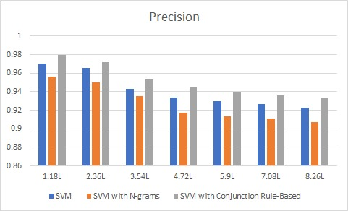
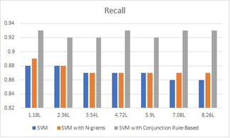
B) Precision of the reviews C) Recall of the Reviews

Slide 22
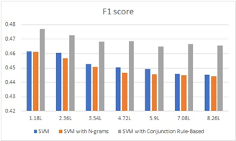
D) F1- Score of the Reviews

Slide 23
Conclusion
In our project, user reviews are obtained from popular websites for different tourism destinations and the sentiments of the reviews are analyzed. In our proposed model we use a machine learning algorithm named Support Vector Machine (SVM) model to predict the sentiments from tourist place reviews and evaluate the performance using an Enhanced Conjunction rule-based approach. The aggregated outcome will help the users to know which place is suitable for traveling and it helps to identify the users more easily. In future work, we shall try to improve our experimental results accuracy by using a larger data set and gathering data from more websites.

Slide 24
Future work
In future work, we can try to improve the accuracy and efficiency of the sentiment analysis of reviews using various Machine Learning Algorithms. Also, we will try to use different feature selection methods like recursive feature elimination with cross-validation to improve the accuracy of classification. In future work, we will try to use deep learning-based techniques for feature extraction and classification for better performance.

Slide 25
References
S. Mutalib, A. H. Razali, S. N. K. Kamarudin, S. A. Halim, and S. Abdul-Rahman, “Prediction of Tourist Visit in Taman Negara Pahang, Malaysia using Regression Models,” Int. J. Adv. Comput. Sci. Appl., vol. 12, no. 12, pp. 746–754, 2021, doi: 10.14569/IJACSA.2021.0121292.
M.D.Devika, C.Sunitha, Amal Ganesh “Sentiment Analysis: A Comparative Study on Different Approaches” ScienceDirect Fourth International Conference on Recent Trends in Computer Science Engineering https://doi.org/10.1016/j.procs.2016.05.124
Harpreet Kaur, Veenu Mangat, Nidhi ”A Survey of Sentiment Analysis techniques ” 2017 International Conference on I-SMAC (IoT in Social, Mobile, Analytics and Cloud) (I-SMAC) DOI: 10.1109/ISMAC.2017.8058315

Slide 26
Thank You!

